Slide 1
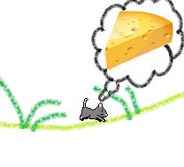

Cheese Please!
Created by: Sarah Medeiros, Josh Karnofsky, & Karen Bouchard

Slide 2
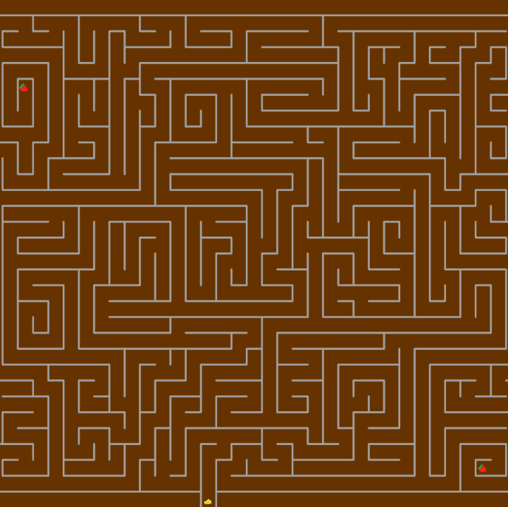
The Basics:
Use the arrow keys or w, a, s, and d, to navigate the mouse around the maze
Collect Fruit for a better score
First go through the underground maze and then through the house in order to complete the game

Slide 3
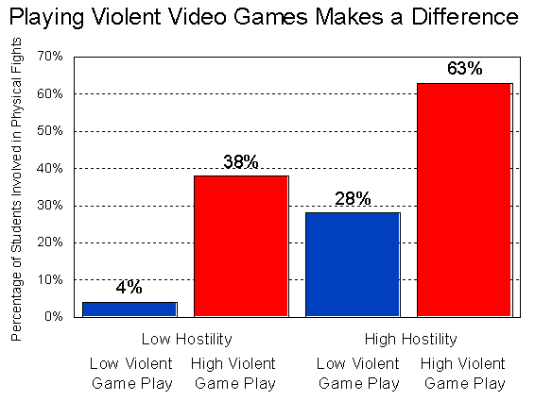
For those who are sick of violent games…
Instead, stimulate your mind with a challenging game of Cheese Please

Slide 4




Fun and Exciting for Every Age!
Each level presents a harder maze to keep the player interested.

Slide 5
Any Questions?
Thank You!

